Slide 1
Healthcare Business Analysis
SQL Server | Power BI | DAX | Visualization

Slide 2
introduction
Patient Encounter Cost and Risk Analysis in Healthcare Systems
Healthcare organizations face increasing challenges in managing the costs and financial risks associated with patient encounters. Identifying patients with frequent high-cost encounters, analyzing the impact of various medical procedures, and understanding financial risks due to payer coverage gaps are critical for improving operational efficiency and patient outcomes. Using SQL server and Power BI, this project aims to provide a comprehensive analysis of patient encounters, procedure costs, and payer coverage to uncover patterns of high-cost healthcare utilization and potential financial risks.

Slide 3
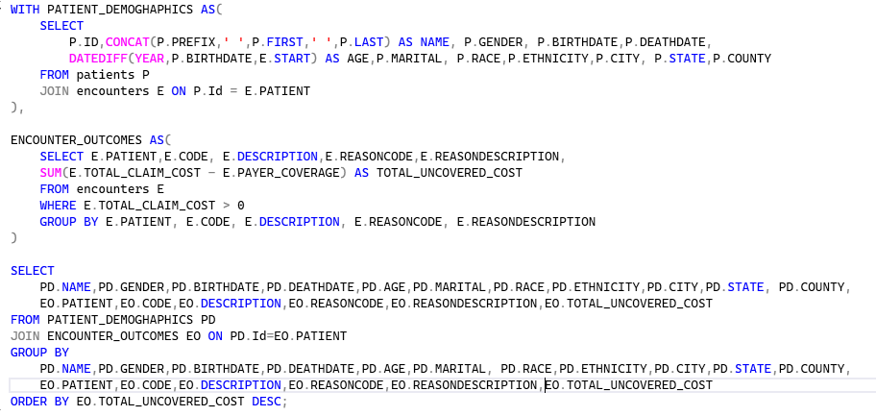
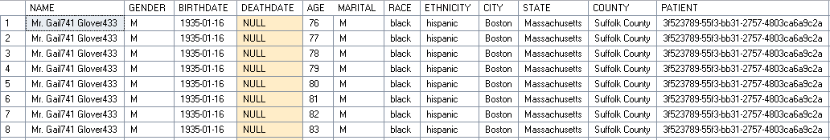
Objective: Determine which ReasonCodes lead to the highest financial risk based on the total uncovered cost (difference between total claim cost and payer coverage). Analyse this by combining patient demographics and encounter outcomes.
1) Evaluating Financial Risk by Encounter Outcome

Slide 4
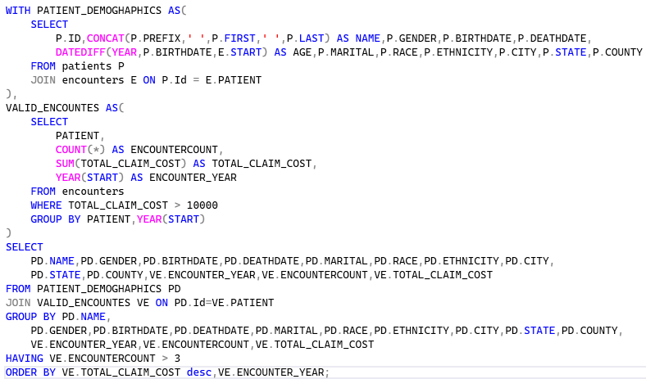
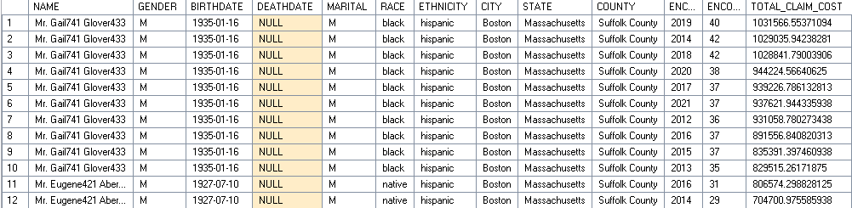
2) Identifying Patients with Frequent High-Cost Encounters Objective: Identify patients who had more than 3 encounters in a year where each encounter had a total claim cost above a certain threshold (e.g., $10,000). The query should return the patient details, number of encounters, and the total cost for those encounters.
2) Identifying Patients with Frequent High-Cost Encounters

Slide 5
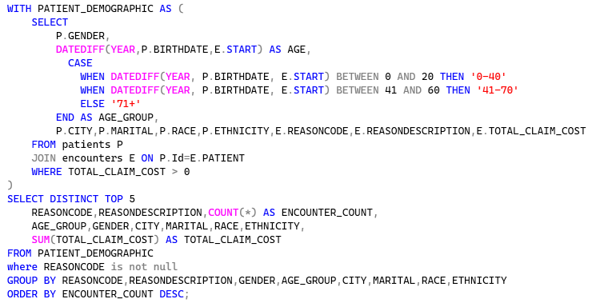
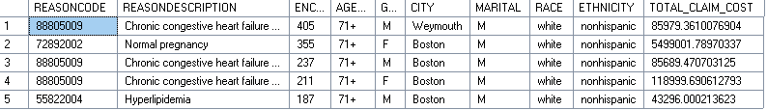
3) Identifying Risk Factors Based on Demographics and Encounter Reasons Objective: Analyze the top 3 most frequent diagnosis codes (ReasonCodes) and the associated patient demographic data to understand which groups are most affected by high-cost encounters.
3) Identifying Risk Factors Based on Demographics and Encounter Reasons

Slide 6
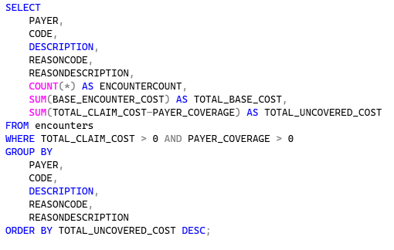
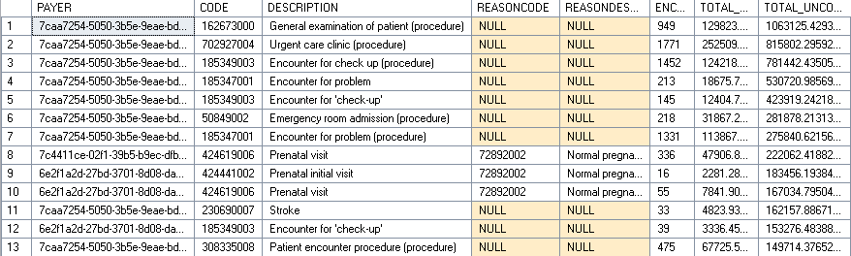
4) Assessing Payer Contributions for Different Procedure Types Objective: Analyze payer contributions for the base cost of procedures and identify any gaps between total claim cost and payer coverage.
4) Assessing Payer Contributions for Different Procedure Types

Slide 7
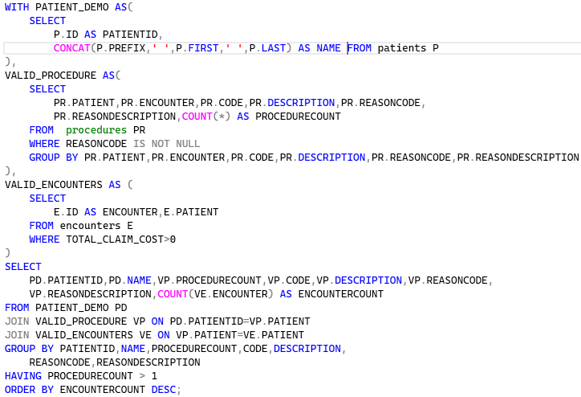
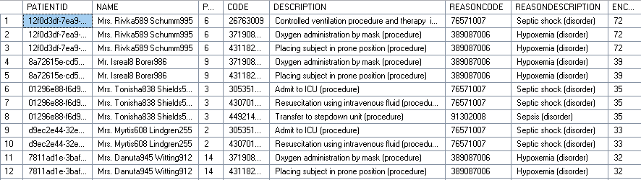
5) Identifying Patients with Multiple Procedures Across Encounters Objective: Find patients who had multiple procedures across different encounters with the same ReasonCode.
5) Identifying Patients with Multiple Procedures Across Encounters

Slide 8
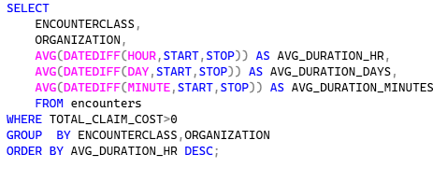
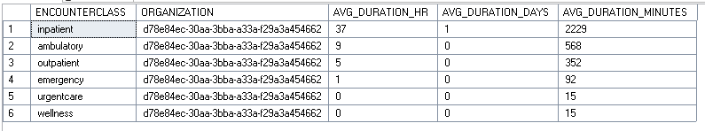
6) Analyzing Patient Encounter Duration for Different Classes Objective: Calculate the average encounter duration for each class (EncounterClass) per organization, identifying any encounters that exceed 24 hours.
6) Analyzing Patient Encounter Duration for Different Classes

Slide 9
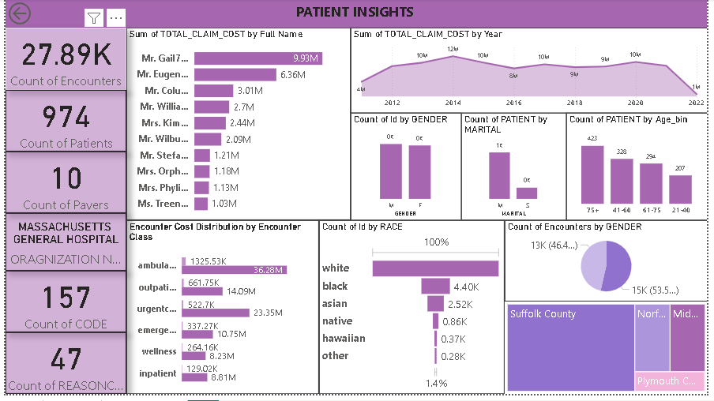

Slide 10
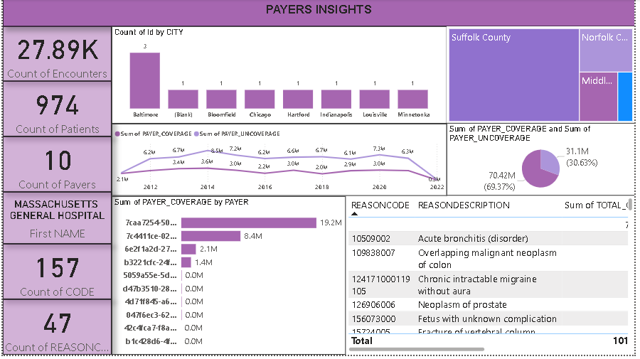

Slide 11
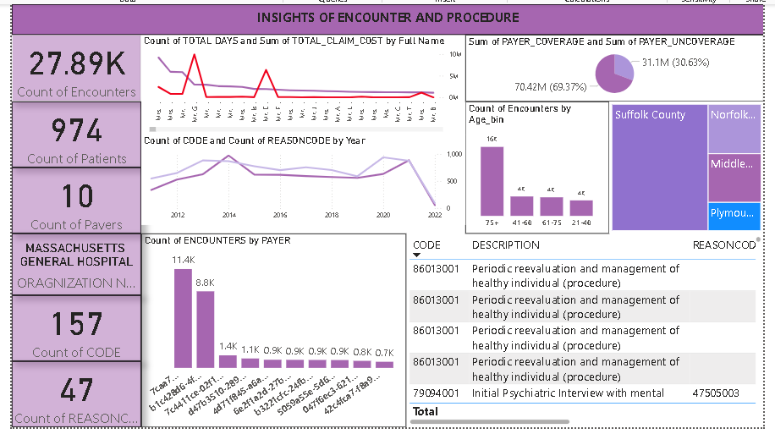

Slide 12
Key findings
Patients :
The data shows that 974 patients generated 27.89K encounters at Massachusetts General Hospital, with White patients representing the highest racial group. Highest volume among middle aged adult (41-60) and slightly more female than male patients.
Suffolk County (Boston) accounts for the majority with 644 patients and 17.9K encounters, while the average total claim cost is $3,948.42. Mr. Gali741 alone incurred nearly $10M in total claim cost, and the highest yearly claim cost occurred in 2014.
Payers:
The dashboard shows that 10 payers were involved in covering 974 patients, resulting in a total of 27.89K encounters. Out of the total claim cost, only 30.63% ($31.1M) was covered by payers, while a significant 69.37% ($70.42M) remained uncovered.
Suffolk County, led by the city of Boston, contributed the highest share with 644 patients and $22.08M in payer coverage, averaging $3,948.42 per patient. One high-cost patient alone accounted for $19.2M in coverage, indicating heavy concentration of spending. The payer coverage peaked in 2014 at around $6.7M, followed by a gradual decline in subsequent years

Slide 13
Key findings
Encounters and procedures :
A total of 27,889 encounters were recorded between 2011 and 2022, with the highest number in 2014 (3,885 encounters) and the lowest in 2022 (220 encounters).
The total claim cost peaked in 2014 at $12M, while the payer coverage was highest in the same year at $3.55M.
On average, claim costs per encounter ranged from $2,599 (2021) to over $4,300 (2012), showing fluctuation in healthcare expenses over time.
The most frequent procedures were:
"Encounter for problem (procedure)" – 4,308 times
"Urgent care clinic (procedure)" – 3,633 times
"Encounter for check-up (procedure)" – 2,950 times
"General examination of patient" – 1,880 times
"Encounter for symptom" – 1,824 times
The number of unique procedures per year ranged from 27 (2022) to 46 (2018), indicating a diverse range of treatments, especially in mid-years

Slide 14
thank you
Pranoti Malgunkar
pranotimalgunkar1996@gmail.com

